Slide 1
ENSC 450: Register File
Barry Yim byim@sfu.ca
Cheng Jie (Jadan) Ou jou@sfu.ca
Bonnie Ha bha20@sfu.ca

Slide 2
Outline
Scope of Presentation:
Designed Register File in VHDL
Performed automated layout implementation of Register File
Record timing anaylsis and understand design trade-offs
Description of Register File
Methodology: Front End & Back End Design
Results
Conclusion

Slide 3
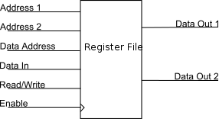
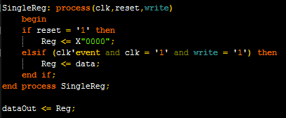
Register File
Contains 32 16-bit registers
Block Diagram: Single Register:
Functions:
Writes data to specified Data Address location when Write is enabled
Outputs data from specified Address1 and Address2 registers
VHDL was written by ourselves, with Fabio’s assistance

Slide 4
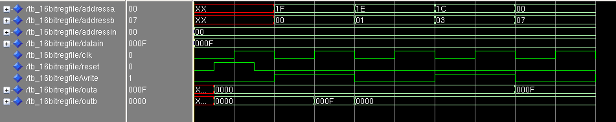
Register File (2)
Application:
Used as temporary storage inside CPU to store values, such as computational, counters, pointers, etc.
Testbench Inputs:
AddressA, AddressB, AddressIn, DataIn, Clk, Reset, and Write signals as shown below

Slide 5
Methodology – Front End Design
Using ModelSim, simulate testbench for expected behaviour
Using Synopsys Design Compiler, perform logic synthesis
To evaluate the best possible achievable performance and area/power penality, synthesis design unconstrained (at a high period) and constrained (at the faster possible period)
Evaluate timing, area, and power results
Optimize Design by selecting reasonable period
Using ModelSim, verify expected behaviour of synthesized netlist

Slide 6
Synthesis Results
Critical Path: from addressA[1] to outA[0]
Longest delay is input external delay = 0.80ns
Input external delay is due to input and output wires parasitic from the clock to the register
Total data arrival time = 2.60ns
Period (ns) | Frequency(MHz) | Area (um^2) | Data Arrival Time (ns) | MET/VIO | Total Dynamic Power (uW)
3.25 | 308 | 5977.020115 | 2.44 | MET | 1487.3
3.5 | 286 | 5962.656114 | 2.6 | MET | 1367.8
7 | 143 | 5962.390114 | 2.6 | MET | 683.8518
10 | 100 | 5962.390114 | 2.6 | MET | 478.6962
15 | 67 | 5962.390114 | 2.6 | MET | 319.1308
25 | 40 | 5962.390114 | 2.6 | MET | 191.4785

Slide 7
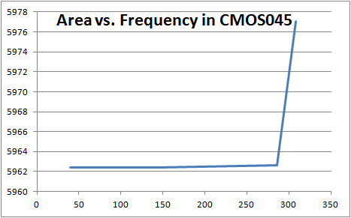
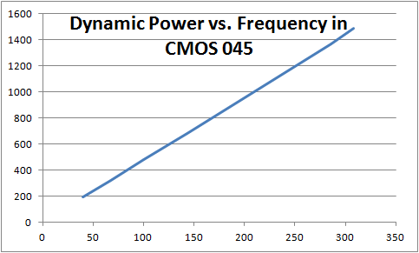
Optimization
Plotting the results:
The highest frequency we can run our circuit at without compromising area is at 286MHz
Additionally, 40Mhz is the lowest frequency we can run our circuit at without violating setup times
Thus, we will perform Back End Design at 286MHz (period = 3.5ns) and 40Mhz (period = 25ns)

Slide 8
Methodology – Back End Design
Using Encounter and scripts provided, perform:
Import Design & Floor Planning
Placing & Optimization
Clock Tree Synthesis & Optimization
Routing & Finishing
Checked session logs for errors and major warnings. Also, checked reports for design violations
Analyzed timing reports and summaries

Slide 9
Constraints
Using TT transistor characteristics with 045nm technology at 25ºC, constrained design with a 3.5ns and 25ns clock period.
Fitted design into a chip with an area of ~8000um².
Floor plan density = 90%
Period | Max Clock Skew | Max Latency
25ns | 0.625ns | 3.29ns
3.5ns | 0.686ns | 3.28ns

Slide 10
Back End Design Results
Period 3.5ns:
Since our circuit is a Register File, speed is important. Hence, it would be best to run at 3.5ns for faster arrival time, despite small increase in area and density
Period 25ns:
Stage | Number of Cells | Cell Area μm2 | Density | Data Arrival Time
Post-Synthesis | 3647 |  |  | 2.3439
Placing | 3518 | 5807.844 | 87.66% | 2.65340
Post-Place OPT | 3567 | 5852.798 | 88.34% | 2.61520
CTS | 3682 | 5872.748 | 88.64% | 2.61780
Post-CTS OPT | 3582 | 5874.344 | 88.66% | 2.57260
Routing/Signoff | 3582 | 5874.344 | 88.66% | 2.55380
Finishing | 4667 | 5874.344 | 99.90% | 2.55380
Stage | Number of Cells | Cell Area μm2 | Density | Data Arrival Time
Post-Synthesis | 3647 |  |  | 2.34391
Placing | 3518 | 5807.578 | 87.66% | 2.67560
postplace OPT | 3527 | 5801.194 | 87.56% | 2.68840
cts | 3542 | 5821.144 | 87.87% | 2.67830
post cts OPT | 3542 | 5826.996 | 87.95% | 2.6266
routing/signoff | 3542 | 5826.996 | 87.95% | 2.68661
Finishing | 4880 | 5826.996 | 99.90% | 2.68661

Slide 11
Back End Design Results (2)
After performing Place & Route, we were happy with our results. Thus, no changes to Floor Plan or constraints were applied.
We did not run into any violations in our circuit.
During optimization steps, trial routing was performed to estimate wire loads and delays
Buffers were inserted to decrease timing delays

Slide 12
Conclusion
Chose to conclude with a Register File made with 45nm technology and 3.5ns clock period
Compared to the 25ns clock period, area is basically the same
Can run 7x faster than 25ns clock period
At Period=3.5ns, the performance of our device is:
Area of Standard Cells: 5874.344 μm²
Cell Utilization: 88.755%
Core Density (without filler cells): 88.66%
Unresolved violations and problems: None
Power Analysis:
Data Arrival Time: 2.55380 ns

